Slide 1
Amazon product review analysis
Pravat Ranjan Pasayat
28th Feb 2020

Slide 2
Agenda
Who am I?
Solution architecture
Analysis approach
Key findings and insights
Takeaways for Takeaway

Slide 3
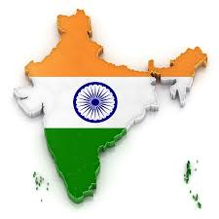






Who am I?
Software Developer
(2012-2013)
Data Analytics Consultant
(2014-2018)
Master in Data Science & Big Data
(2018-2019)
Data Scientist
(2019-2020)
https://www.linkedin.com/in/pravat-pasayat-b6b846ab/

Slide 4




Solution architecture & Data approach
Raw data file
Data manipulation
Clean data file
Analysis & Visualization

Slide 5
Analysis approach
General analysis
Reviewer segmentation
Cross buy analysis
Category analysis
Timelines analysis
Rating analysis
Helpfulness analysis
Price analysis
Brand analysis
Segmentation of reviewers
Current approach
Futuristic approach
Analysis of products bought together
Current approach
Future approach

Slide 6
Summary
Category analysis
Highest # of reviews are on categories - Clothing, Watches & Jewelry.
Highest product rating is for category - home improvement.
Highest helpfulness review scores are on categories - Cell phone accessories and Camera/photo.
Highest product prices are on categories - Cell phone accessories, Camera/photo and Electronics.
Timeline analysis
# of reviews has been increasing over time.
Highest # of reviews are on holiday months (December and January).
Highest # of reviews are on first 3 working days of the week (Monday, Tuesday and Wednesday).
Product rating analysis
Users are buying more and more high rated products over the years.
Highly rated products are bought and reviewed the most.
Lowest rated products have high review helpfulness index.
Highest rated products are the more expensive.
Review helpfulness analysis
Helpfulness of reviews are reducing over time.
Review is more helpful when it has more text in it.
Costly products have more helpful reviews.
Notes:
Reviewers with avg. helpfulness % >70% are rating products < 4.0
Develop a campaign to understand and improve the low avg. rating given by them

Slide 7
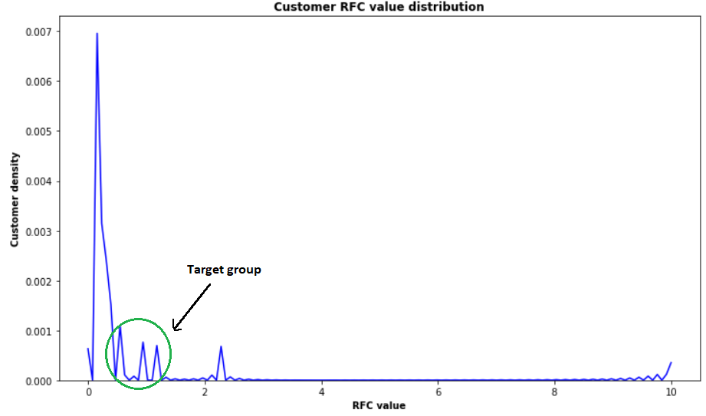
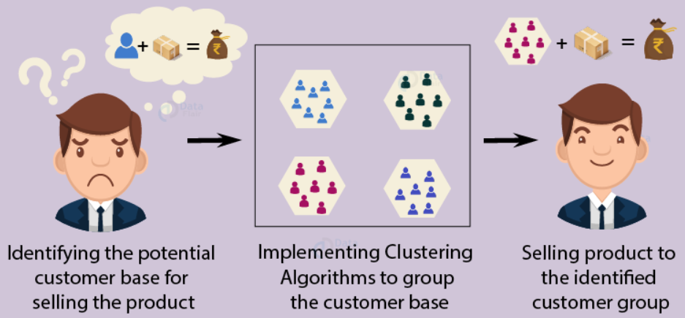
Reviewer segmentation
Current approach
(Statistical)
Futuristic approach (AI & ML)
Based on RFC (Recency – frequency – monetary) value of the customer
Weighted average (Based on organization’s need)
Leave out high and low performers. Target the group with high potential to improve
Gather more data on customer demographics
Use machine learning clustering/segmentation
Algorithms: K-Means etc.
Hit and trial to find perfect clusters that fits organization’s need
* Could have used Avg. product rating & helpfulness score
Notes:
Reviewers with avg. helpfulness % >70% are rating products < 4.0
Develop a campaign to understand and improve the low avg. rating given by them

Slide 8
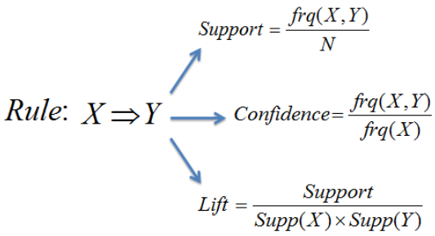
Cross buy analysis
Current approach
Futuristic approach (AI & ML)
Based on data analysis done using python
Reviewers who buy product of avg. rating >4.0 tend to buy products together which are also rated above 4.0
Products from same category are bought together.
Reviewers who buy electronics together are used to go through higher number of reviews before buying another product
Gather data related to shopping basket
Use machine learning association algorithm
Algorithms: Apriori etc.
Find Antecedents → Consequent
Use appropriate evaluation metric

Slide 9
Takeaways
Reviews impact the customer behavior (Number of reviews as important as rating)
In app reviews
Google reviews
Customer segmentation plays a vital role. Segmentation may be based on
Cuisine
Willingness to spend
Time spent on App (Decisiveness)
Frequency – recency - monetary aspect of order
Area ordered from
Health consciousness (based on previous order)
Order timeline (Seasonality & weekend behavior)
Product recommendation can be done based on
Products that are usually bought together in past
Idea from Amazon’s market basket analysis (common loopholes taken into consideration)
* Important factors to consider, since restaurants performance impacts User-App experience -
Restaurant Reputation (Customer acquisition cost)
Accessibility for the riders (impacts delivery time)
Restaurants capability to handle large order numbers (correctness and less cancellations)
Serving time, separate waiting areas for riders
Notes:
Last point – from common belief

Slide 10
Thanks for your attention
Questions?
Pasayat.pravat@gmail.com

